Slide 1
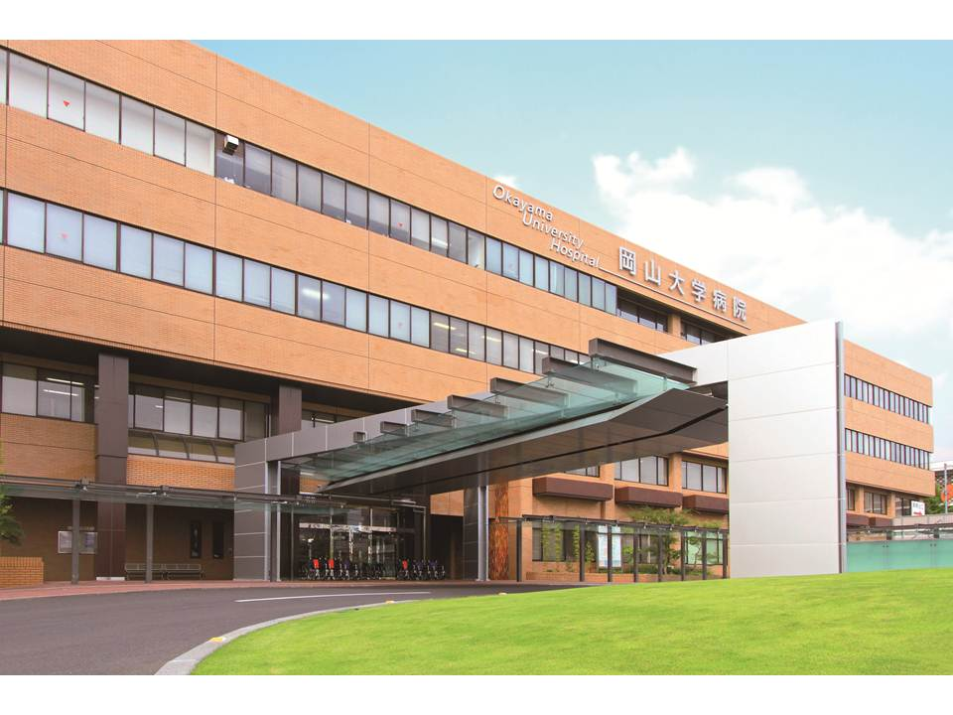
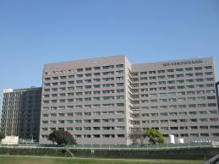
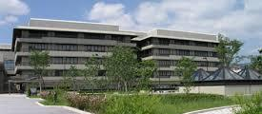
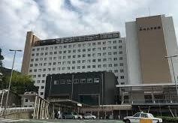
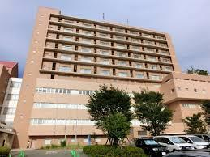
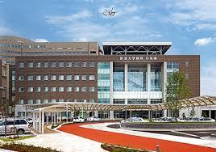
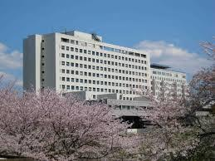
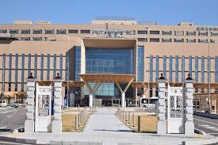
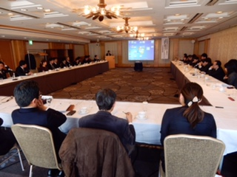
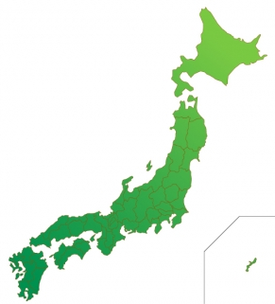
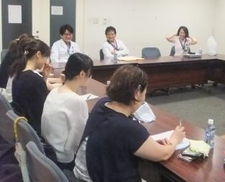
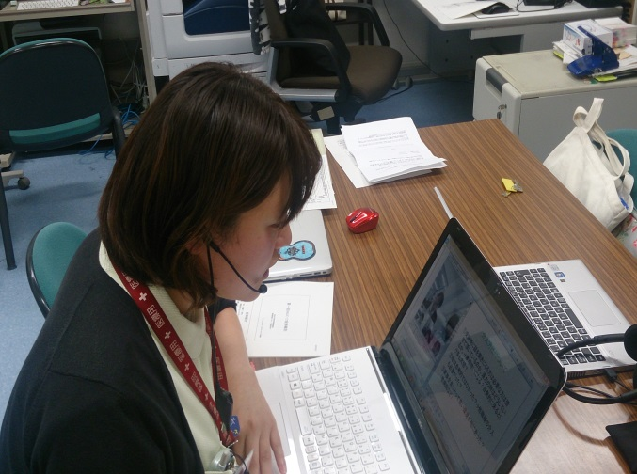
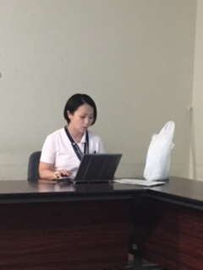
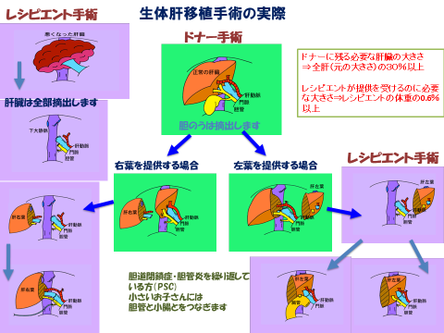
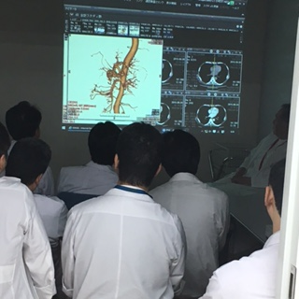
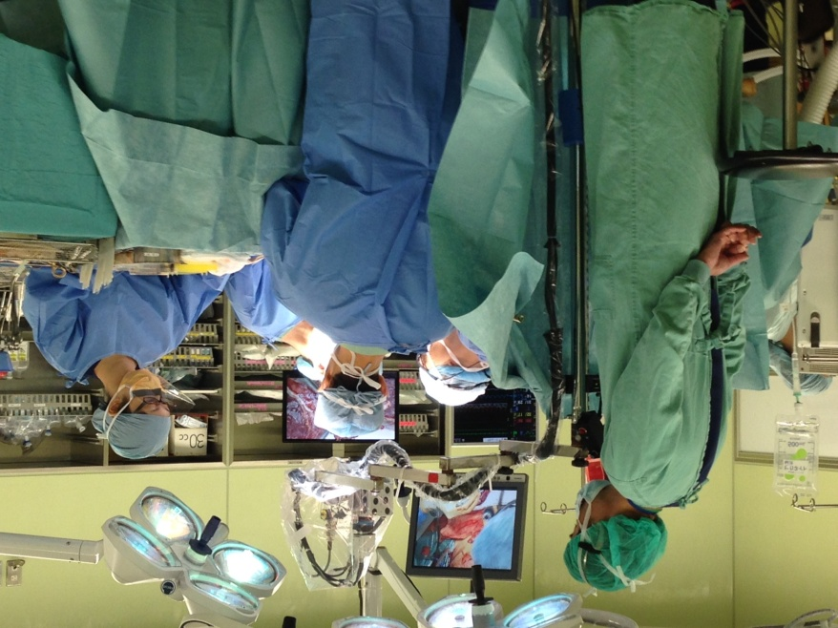
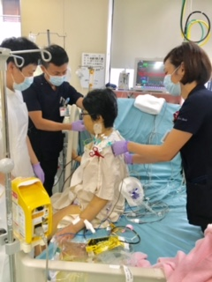
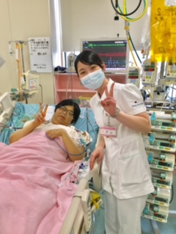
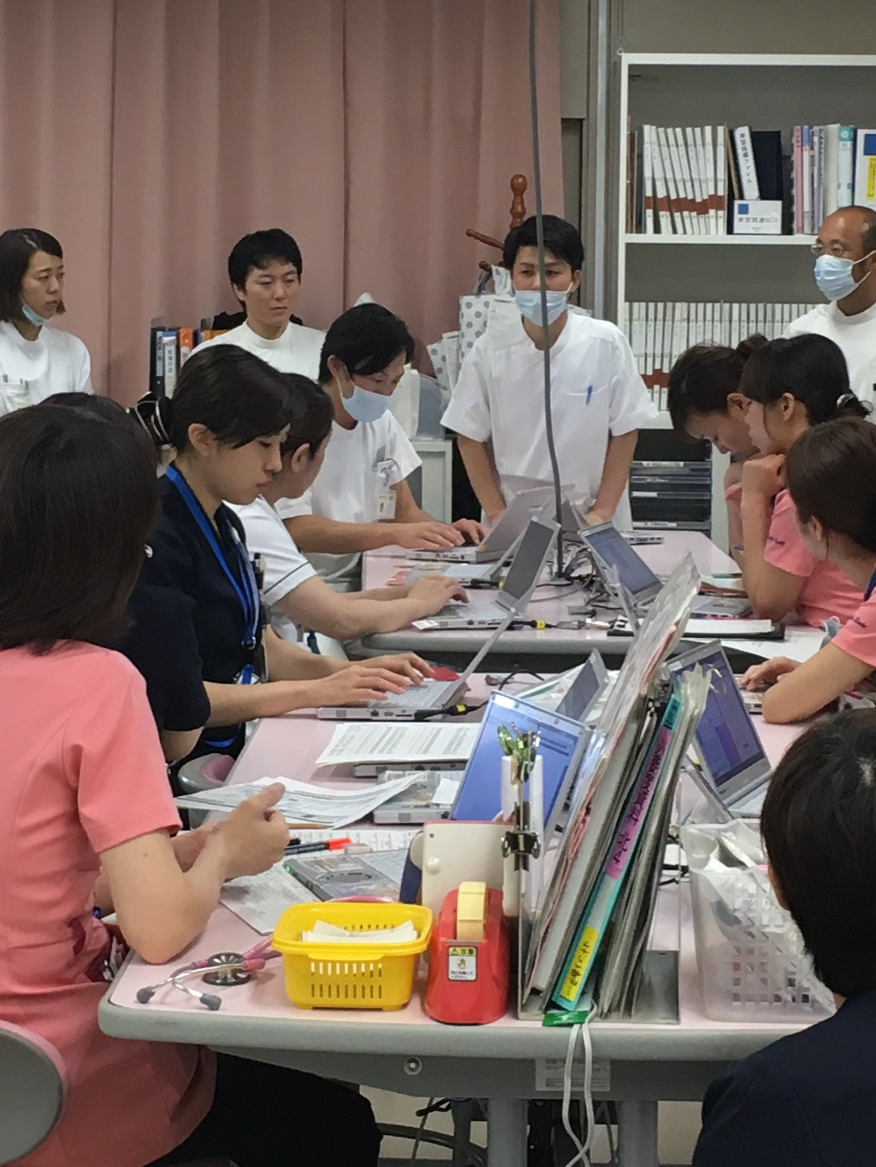
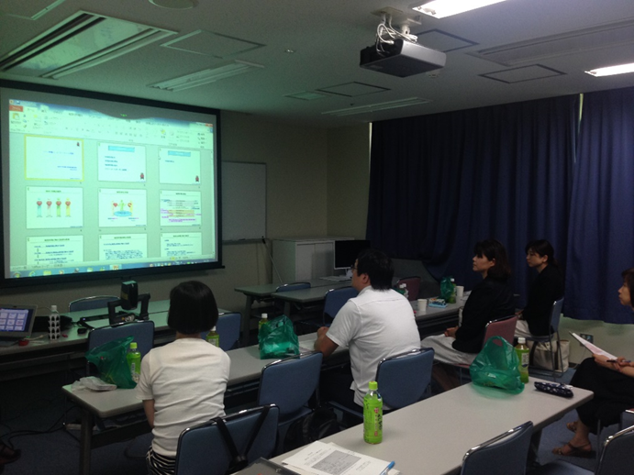
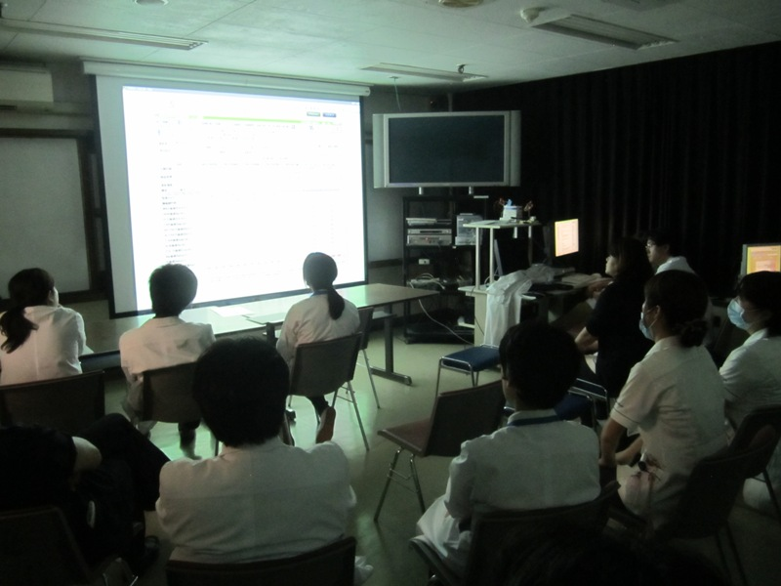
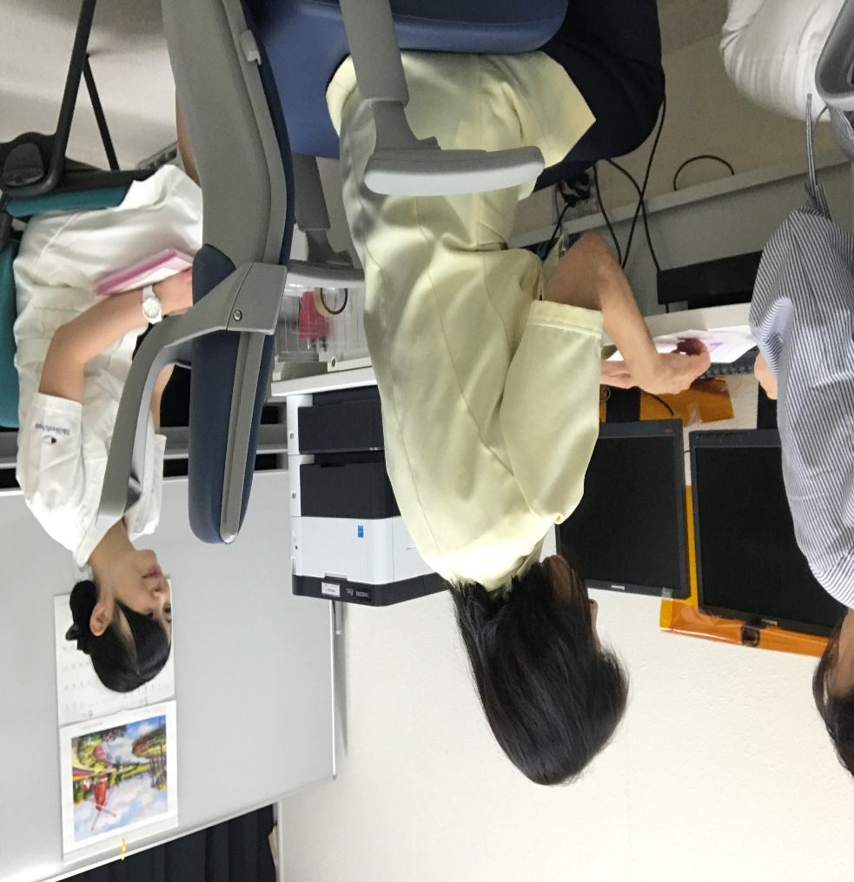
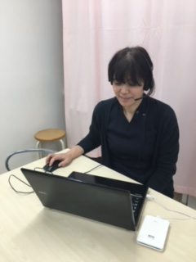
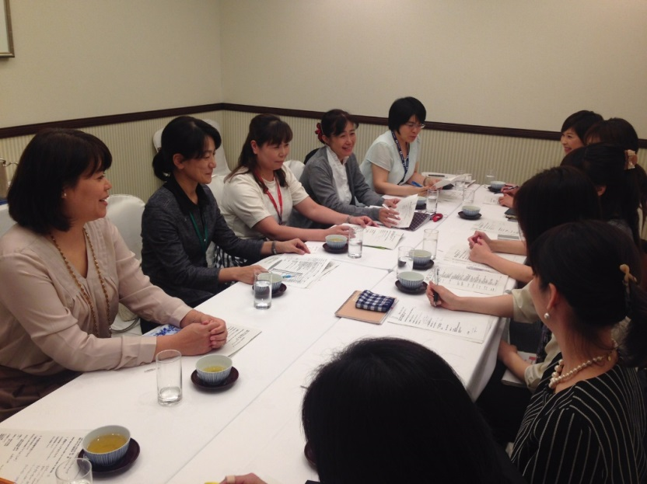
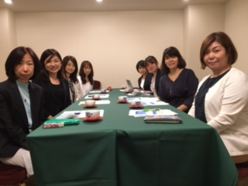
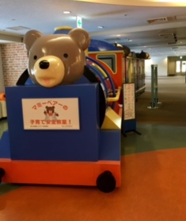
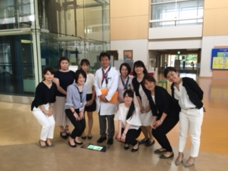
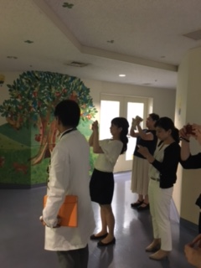
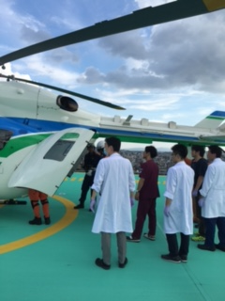
Education of Recipient Transplant Coordinators through a Six National Universities Consortium in a Liver Transplant Professionals Training Program (SNUC-LT) in Japan
YUMI UMEYA RN, CRTCs ¹⁾ MACHIKO NISHIJIMA RN, CRTCs ²⁾ ETSUKO SOEDA PhD, RN, CRTCs ³⁾ YUKIHIRO INOMATA⁴⁾ 1)Division of Nursing, Kyoto University Hospital 2)Division of Nursing, Kumamoto University Hospital
3)Faculty of Nursing and Medical Care, Keio University 4)Prof. Em, Kumamoto University Hospital
Background
Characteristic of the Japanese
Liver Transplant Donors
Role of RTCs
Recipient Transplant Coordinators (RTCs) support both recipients and donors continuously during all processes of live donor transplantation. RTCs are also required to have abilities to conduct communications among professionals related to Certification system for RTC was started by the Japan Society for Transplantation in 2011. However there were mainly lecture type educations. Kumamoto University launched Consortium for a Liver Transplant Professionals Training Program with five other National University Hospitals in 2014, which provided a new training program in Japan, with respecting bedside training for surgeons, pathologists and RTCs. Kyoto University and National Center of Child Health and Development have joined the program as guidance cooperation facilities.
More than 90% are living donor
Initial clinics for transplantation
Donor evaluation
Recipient evaluation
Waiting period
Post transplant management
Transplantation
Follow up at out patient clinic
Life long
RTCs take care of both transplant recipients and living donors simultaneously.
Continuous support in
all processes.
Six National Universities Consortium in a Liver Transplant Professionals Training Program (SNUC-LT) 2014～2018
Purpose
【Guidance cooperation facilities】
To evaluate the products of the new education and training program for RTCs with “Six National Universities Consortium in a Liver Transplant Professionals Training Program (SNUC-LT)”
Kumamoto University
Major transplant centers.
Okayama University
Kyoto University
Surgeons
・Practical training
（140 hr. +)
・Surgical Practice
@transplant major facilities
(3 facilities + )
Pathologists
・Practical Training
（50 hr. +)
・Work experience
@transplant major facilities （10 days ＋）
Coordinators
・Practical
training
(20 days +)
・Case experience
@transplant major
facilities
(10 cases +)
National Center for Child
Health and Development
Programs of SNUC-LT
Nagasaki University
Future Goal of Training System
Create standard and conformity assessment system
Key Lectures by senior RTCs.
Joint meeting held by SNUC-LT and programs sponsored by the Japanese Society for Transplantation.
③ Case conferences using Teleconference system.
④ Bedside training at major transplant centers.
Kick-off meeting under 6 university
(Faculty Meeting)
Niigata University
Kanazawa University
Chiba University
{Supported by Ministry of Education Culture, Sports, Science and Technology of Japan.}
Results Trainees (7 coordinators)
So far total 7 members attended during
Practical Training Details
Facility | # Transplant (-2015) LDLTX(DDLTX) | Trainees | Experience as RN (years) | Experience as RTC (years) |  | # Lecture Join Meeting (Time) | # Clinical training (Time(Day)) | Enrollment (years) | Experienced case
Kumamoto | 461 Case（9） | A B | 26 11 | 3 0 |  | 24.5 20 | 48 （6） 40 (5） | 2 1 | 25 0
Okayama | 371（25） | C | 8 | 3 |  | 35.5 | 120（15） | 2 | 28
Chiba | 56（3） | D E | 8 5 | 3 0 |  | 20.5 8.5 | 64 （8） 64（8） | 1 Ongoing | 1 0
Kanazawa | 56（3） | F | 28 | 0 |  | 20 | 80（10 ） | 1 | 8
Niigata | 114（3） | G | 18 | 0 |  | 13.5 | 24 （3） | Ongoing | 0
Key Lectures Meetings with Case Conferences (171hours)
Clinical Training at major transplant Centers (440hours)
Topics
Decision making process from the time of initial meeting
Support recipients and families pre- and post- transplantation
Management of immunosuppression at out patient clinic
Management of team conferences
Deceased Donor Transplant case
*Lectures *Meetings *Case Conferences *Clinical Training at major Centers
Lectures by Doctor, Pharmacologist, RTCs
and Procurement Coordinators
Case conferences using Teleconference
Clinical Training at Kumamoto university hospital Kyoto university hospital
Initial meeting for transplantation
Recipients and living donor evaluation
Surgery
Post-transplant management
Transplant team conference
Follow-up out-patient
Deceased Donor Transplant
Pediatric Liver Transplant
Japan
Ethics in Transplantation
Immunosuppression
National Center for Child Health and Development
Deceased donor transplantation case
Conclusion
① This program was effective and efficient to share knowledge and
experience among RTCs to brush up their clinical skills.
② This program was beneficial in a way to build good communication
among institutions.
③This program will broaden RTCs vision by experiencing different
system and cases of other institutions.
④This program was effective to enlarge the potential pool for future RTCs.
More education （Clinical Training） programs are necessary in order to standardize RTCs role in Japan.
These opportunities are important to build up personal network among RTCs and to level up their skills.

